Slide 1

Java 16 New Features
Dima Ionut Daniel

Slide 2
Contents
What is Java?
History
Java Flavors
New Features
Core
Other Improvements
Bibliography

Slide 3

What is Java?
Java is a programming language created by Sun Microsystems.
Java is used in a wide variety of computing platforms from embedded devices and mobile phones on the low end, to enterprise servers and supercomputers on the high end.
Memory management is handled through integrated automatic garbage collection performed by the JVM.
The heart of the Java platform is the concept of a "virtual machine" that executes Java bytecode programs. This bytecode is the same no matter what hardware or operating system the program is running under.
There is a JIT(Just-In-Time) compiler within the Java Virtual Machine, or JVM. The JIT compiler translates the Java bytecode into native processor instructions at run-time and caches the native code in memory during execution.
The Java programs are cross-platform or platform independent, but the code of the Java Virtual Machines (JVM) that execute these programs is not.

Slide 4
History
The initial Java release was named Oak, and the first stable version was JDK 1.0.2, called Java 1.
JDK 1.0 - 23 January 1996
JDK 1.1 – 19 February 1997
J2SE 1.2 – 8 December 1998 (codename Playground)
J2SE 1.3 – 8 May 2000 (codename Kestrel)
J2SE 1.4 – 6 February 2002 (codename Merlin)
J2SE 5.0 – 30 September 2004 (codename Tiger)
Java SE 6 – 11 December 2006 (codename Mustang)
Java SE 7 – 7 July 2011(codename Dolphin)
Java SE 8 – 18 March 2014 (codename Spider)

Slide 5
History (cont.)
Java SE 9 – 21 September 2017
Java SE 10 – 20 March 2018
Java SE 11 – 25 September 2018
Java SE 12 – 19 March 2019
Java SE 13 – 17 September 2019
Java SE 14 – 17 March 2020
Java SE 15 – 16 September 2020
Java SE 16 – 16 March 2021

Slide 6
Java Flavors
The Java distribution comes in different flavors:
Java Card →run securely on smart cards and similar small-memory devices.
Java ME(Micro Edition) → Specifies several different sets of libraries (known as profiles) for devices with limited storage, display, and power capacities.
Java SE(Standard Edition) → for general-purpose use on desktop PCs, servers and similar devices.
Java EE(Enterprise Edition) → Java SE plus various APIs useful for multi-tier client–server enterprise applications.

Slide 7
New Features
JDK-8159746 - Invoke Default Methods From Proxy Instances
JDK-8247781 - Day Period Support
JDK-8180352 - Add Stream.toList Method
JEP-338 - Vector API Incubator
JEP 376: ZGC Concurrent Stack Processing
JEP 380: Unix domain sockets
JEP 390: Warnings for Value-based Classes
JEP 393: Foreign-Memory Access API (Third Incubator)
JEP-394 - Pattern Matching for instanceof
JEP-395 – Records
JEP 396: Strongly Encapsulate JDK Internals by Default
JEP-397 - Sealed Classes
JEP 389: Foreign Linker API (Incubator)
JEP 392: Packaging Tool

Slide 8
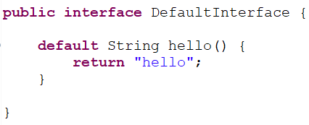
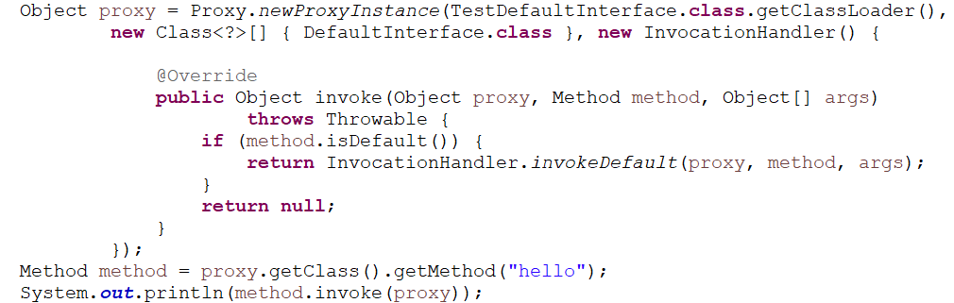
Core
As an enhancement to the default method in Interfaces, with the release of Java 16, support has been added to java.lang.reflect.InvocationHandler invoke default methods of an interface via a dynamic proxy using reflection.

Slide 9
Core (cont.)
A new addition to the DateTimeFormatter is the period-of-day symbol “B“, which provides an alternative to the am/pm format.

Slide 10
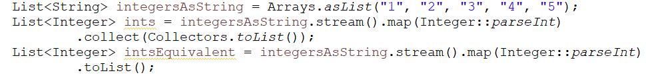
Core (cont.)
The new method Stream.toList() is to reduce the boilerplate with some commonly used Stream collectors, such as Collectors.toList and Collectors.toSet:

Slide 11
Core (cont.)
The Vector API is in its initial incubation phase for Java 16.
This API provides a means of vector computations that will ultimately be able to perform more optimally (on supporting CPU architectures) than the traditional scalar method of computations.

Slide 12
Core (cont.)
Records were introduced in Java 14.
Java 16 adds some enhancements.
Records are like enums in the fact that they are a restricted form of class.
Defining a record is a concise way of defining an immutable data holding object.
From java 16 we can define records as class members of inner classes.

Slide 13

Core (cont.)
Sealed classes, were introduced in Java 15 and provide a mechanism to determine which sub-classes are allowed to extend or implement a parent class or interface.
The sealed keyword is used in conjunction with the permits keyword to determine exactly which classes are allowed to implement this interface. All inheriting classes of a sealed class must be marked with one of the following:
sealed → meaning they must define what classes are permitted to inherit from it using the permits keyword.
final → preventing any further subclasses
non-sealed → allowing any class to be able to inherit from it.

Slide 14
Core (cont.)
There are a few additions to sealed classes in Java 16. These are the changes that Java 16 introduces to the sealed class:
The Java language recognizes sealed, non-sealed, and permits as contextual keywords (like abstract and extends)
Restrict the ability to create local classes that are subclasses of a sealed class (like the inability to create anonymous classes of sealed classes).
Stricter checks when casting sealed classes and classes derived from sealed classes

Slide 15
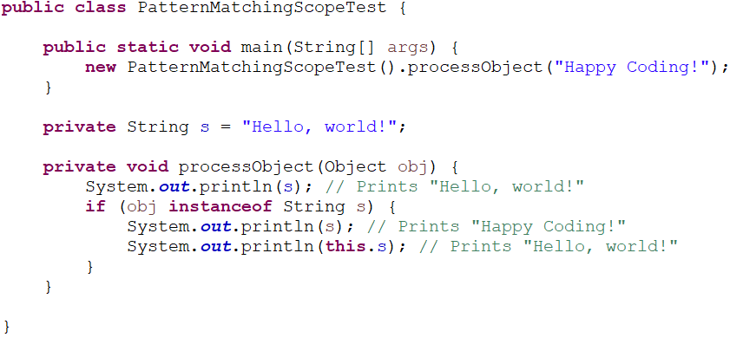
Core (cont.)
A matched variable is only visible within the if block.
Only if the if comparison is positive, the variable can be cast to the desired type.

Slide 16
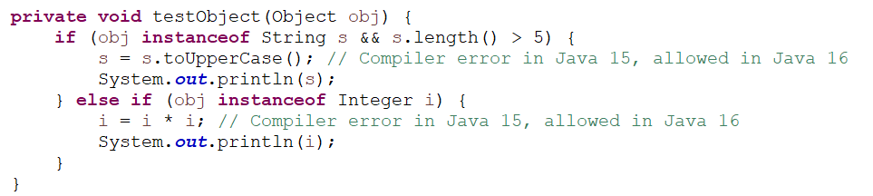
Core (cont.)
Pattern variables are no longer implicitly final, i.e., they can be changed.

Slide 17
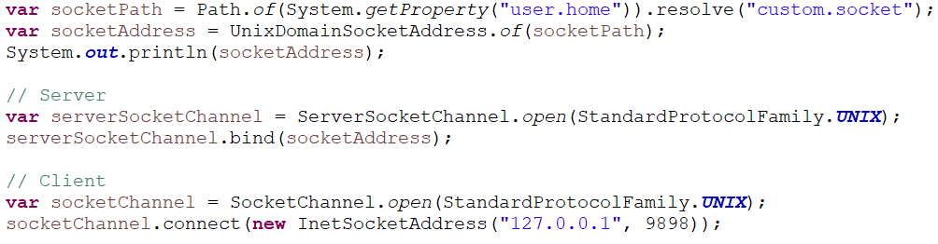
Core (cont.)
Unix-domain sockets are used for inter-process communication (IPC) within a host.
They are like TCP/IP sockets but are addressed via file system paths, not IP addresses.
They are more secure (no access possible from outside the host) and provide faster connection initiation and higher throughput than TCP/IP loopback connections.
With JEP 380, Java developers can now also use Unix-domain sockets.
Unix-domain socket support has been integrated into the existing SocketChannel and ServerSocketChannel APIs.

Slide 18
Other Improvements
With JEP 396, JDK strongly encapsulate all internal elements of the JDK by default, except for critical internal APIs such as sun.misc.Unsafe. Allow end users to choose the relaxed strong encapsulation that has been the default since JDK 9.
With this change, the default value of the launcher option --illegal-access is now deny rather than permit.
Therefore, existing code that uses most internal classes, methods, or fields of the JDK will fail to run.
Such code can be made to run on JDK 16 by specifying --illegal-access=permit.
That option will, however, be removed in a future release.

Slide 19
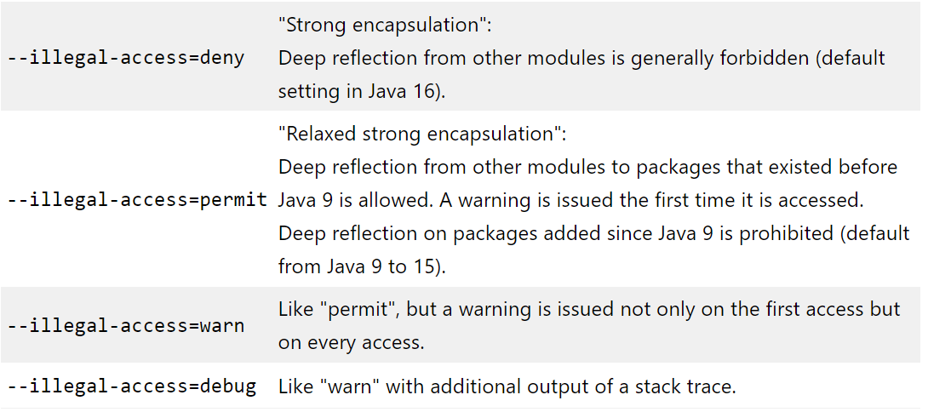
Other Improvements
We can use the VM option "--illegal-access" to restore the previous behavior.

Slide 20
Other Improvements (cont.)
With JEP 376, the Z Garbage Collector now processes thread stacks concurrently.
This allows all roots in the JVM to be processed by ZGC in a concurrent phase instead of stop-the-world pauses.
The amount of work done in ZGC pauses has now become constant and typically not exceeding a few hundred microseconds.

Slide 21
Other Improvements (cont.)
This new feature "concurrently Uncommit Memory in G1" is always enabled and changes the time when G1 returns Java heap memory to the operating system. G1 still makes sizing decisions during the GC pause but offloads the expensive work to a thread running concurrently with the Java application.

Slide 22
Other Improvements (cont.)
The JVM uses the "metaspace" to store class metadata, i.e., all information about a class, such as the parent class, methods, and field names – but not the content of the fields (which is located on the heap).
Depending on the application profile, the metaspace may have an excessively high memory consumption.
JEP 387 reduces the metaspace's memory footprint, and memory is returned faster to the operating system.

Slide 23
Other Improvements (cont.)
With JEP 392, jpackage tool can be used for packaging self-contained Java applications.
The jpackage tool was introduced as an incubating tool in JDK 14 by JEP 343.
It remained an incubating tool in JDK 15, to allow time for additional feedback.
It has been promoted in JDK 16 from incubation to a production-ready feature.
Because of this transition, the name of the jpackage module has changed from jdk.incubator.jpackage to jdk.jpackage.
Supported are:
Windows (exe and msi)
macOS (pkg and dmg)
Linux (deb and rpm)

Slide 24
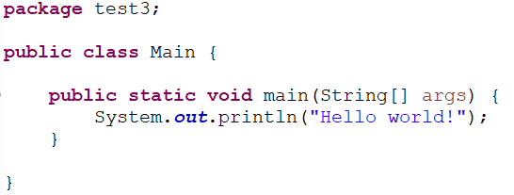
Other Improvements (cont.)
We need to have installed WIX Toolset (requires .NET 3.5) to use jpackage utility.
The WiX Toolset builds Windows installation packages from XML source code.
javac -d target/classes src/test3/Main.java
jar cf lib/test3.jar -C target/classes .
jpackage --name test3 --input lib --main-jar test3.jar --main-class test3.Main

Slide 25
Other Improvements (cont.)
The ThreadGroup methods stop(), destroy(), isDestroyed(), setDaemon() and isDaemon() have now also been marked as "deprecated for removal".
The mechanism for destroying a thread group was poorly implemented in the JDK from the beginning and is to be completely removed in a future version. This also makes the concept of the daemon thread group obsolete.

Slide 26

Bibliography
http://en.wikipedia.org/wiki/Java_(programming_language)
https://www.baeldung.com/java-16-new-features
https://www.happycoders.eu/java/java-16-features/
https://www.oracle.com/java/technologies/javase/16-relnote-issues.html

